Slide 1

Université de Mostaganem — Dr. Madani BELACEL
ICT Tutorial 02 — Computer Science and Computer Architecture
Module TIC — Dr. BELACEL Madani
Université de Mostaganem — MCB

Slide 2
Université de Mostaganem — Dr. Madani BELACEL
🎯 Objectifs pédagogiques
• Comprendre les concepts clés
• Appliquer les compétences
• Évaluer les technologies

Slide 3
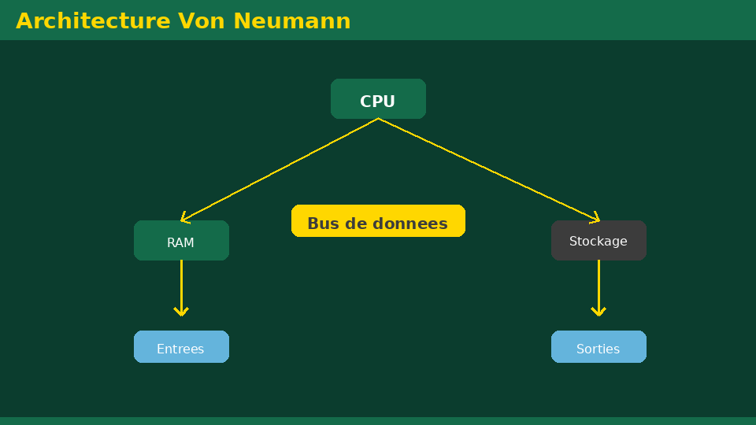
Université de Mostaganem — Dr. Madani BELACEL
📋 Plan du cours
• Exercise 1 — Basic vocabulary(15 min)
• Exercise 2 — Input / Processing / Output(15 min)
• Exercise 3 — RAM vs storage(18 min)
• Exercise 4 — Choice of support(18 min)
• Exercise 5 — Good practices(14 min)

Slide 4
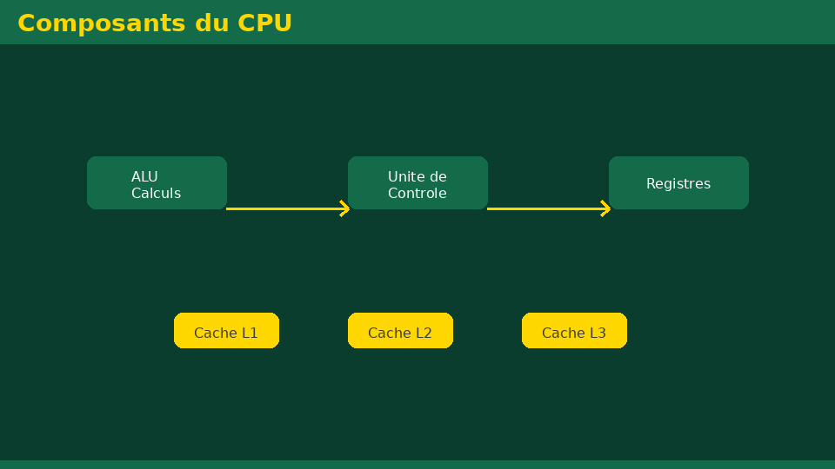
Exercise 1 — Basic vocabulary(15 min)
• Statement:Define: computing, hardware, software, CPU, RAM, SSD.
• Corrected:Computer science = automatic processing of information; hardware = hardware; software = software; CPU = processor; RAM = volatile random access memory; SSD = fast non-volatile storage.
Université de Mostaganem — Dr. Madani BELACEL

Slide 5
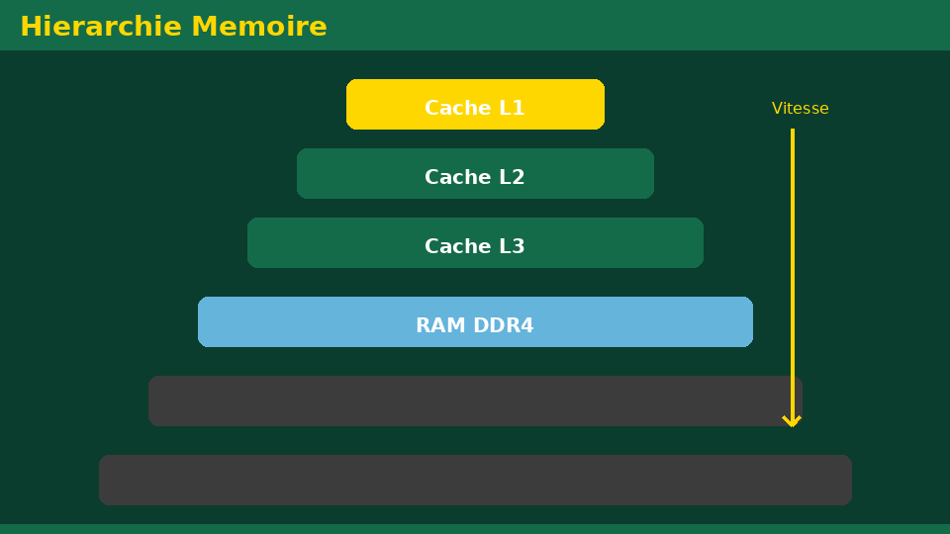
Exercise 2 — Input / Processing / Output(15 min)
• Statement:Classify: keyboard, screen, processor, printer, microphone, hard drive.
• Fixed:Input: keyboard, microphone; Processing: processor; Output: screen, printer; Storage: hard drive.
Université de Mostaganem — Dr. Madani BELACEL

Slide 6
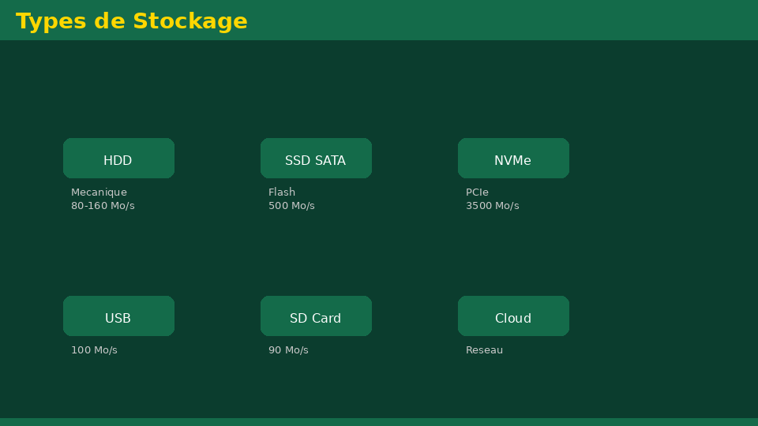
Exercise 3 — RAM vs storage(18 min)
• Statement:Why does an unsaved document disappear after a power outage?
• Fixed:The data being edited is in RAM (volatile). Without saving to disk/SSD/cloud, they are lost when shut down.
Université de Mostaganem — Dr. Madani BELACEL

Slide 7
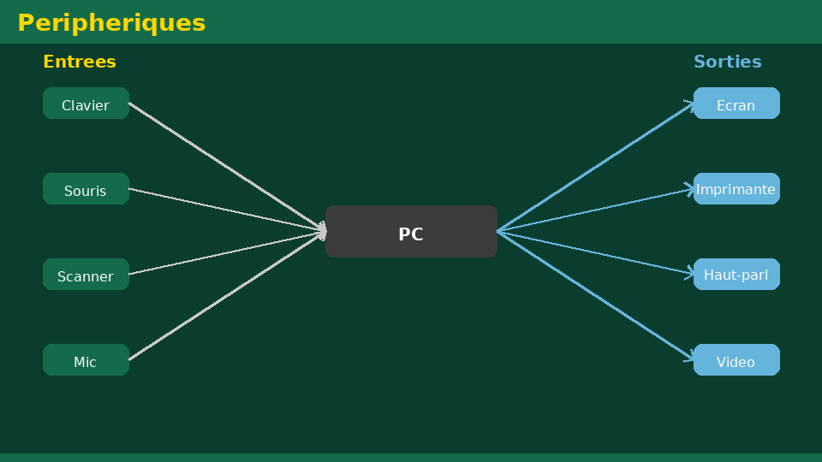
Exercise 4 — Choice of support(18 min)
• Statement:For daily work, long-term archive, file transport — recommend media and justify.
• Fixed:SSD for everyday use; HDD or cloud for archives; USB key for occasional transport.
Université de Mostaganem — Dr. Madani BELACEL

Slide 8
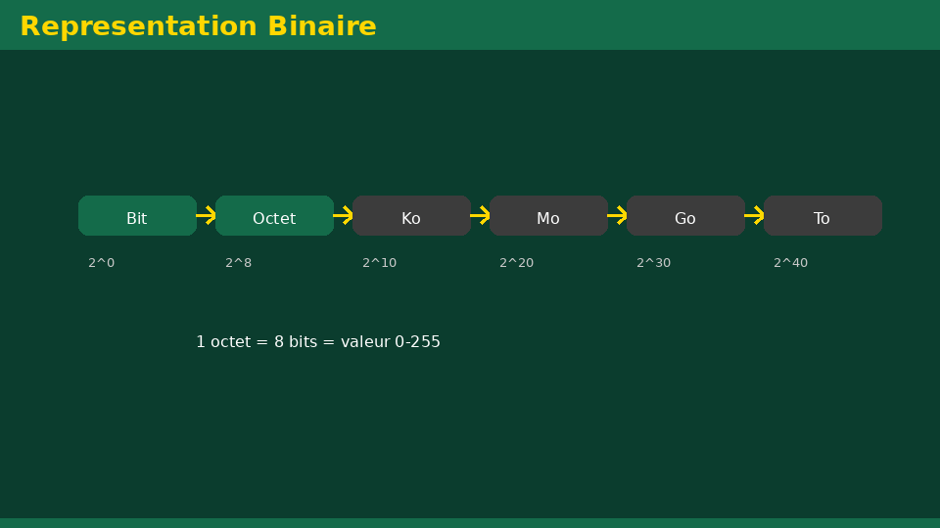
Exercise 5 — Good practices(14 min)
• Statement:List 6 important best practices for a student.
• Fixed:Regular backups, updates, antivirus, folder organization, 3-2-1 rule, RAM/storage distinction.
Université de Mostaganem — Dr. Madani BELACEL

Slide 9
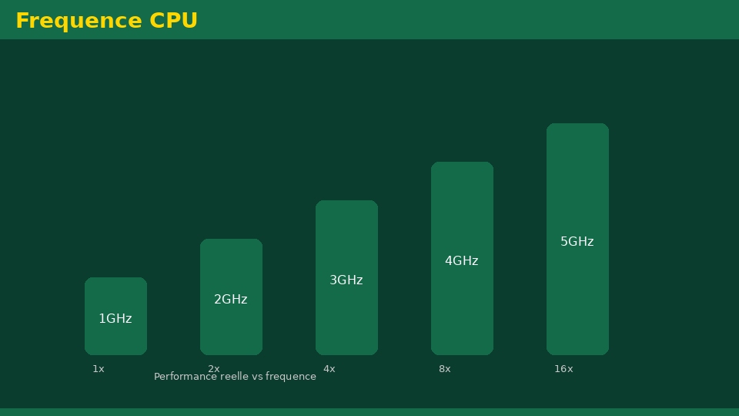
• Statement:Define: computing, hardware, software, CPU, RAM, SSD.
• Statement:Classify: keyboard, screen, processor, printer, microphone, hard drive.
• Statement:Why does an unsaved document disappear after a power outage?
📝 Points clés à retenir
Université de Mostaganem — Dr. Madani BELACEL

Slide 10
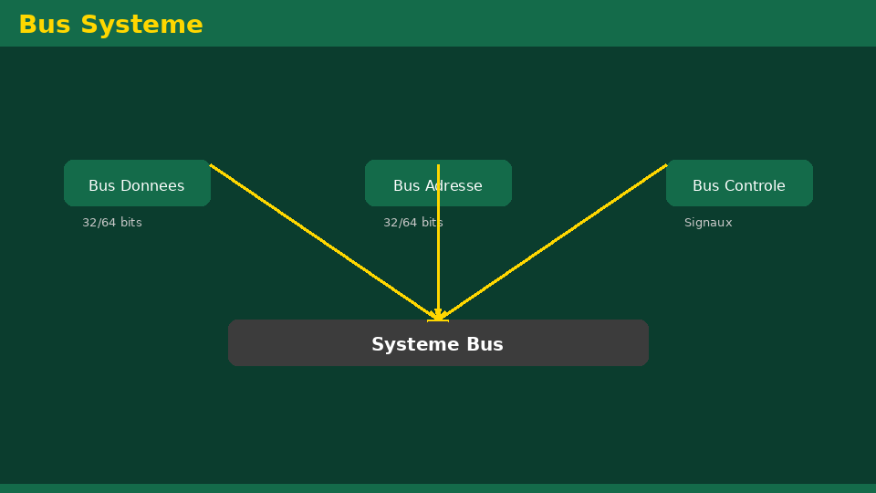
• Statement:Define: computing, hardware, software, CPU, RAM, SSD.
• Statement:Classify: keyboard, screen, processor, printer, microphone, hard drive.
• Statement:Why does an unsaved document disappear after a power outage?
📝 Points clés à retenir
Université de Mostaganem — Dr. Madani BELACEL

Slide 11
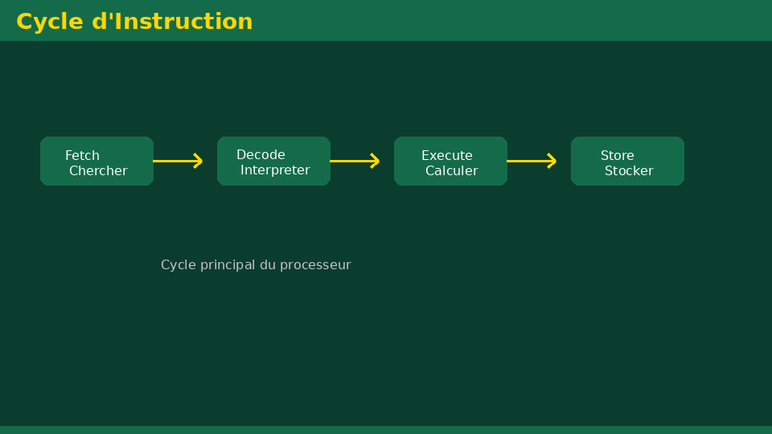
• Statement:Define: computing, hardware, software, CPU, RAM, SSD.
• Statement:Classify: keyboard, screen, processor, printer, microphone, hard drive.
• Statement:Why does an unsaved document disappear after a power outage?
📝 Points clés à retenir
Université de Mostaganem — Dr. Madani BELACEL

Slide 12
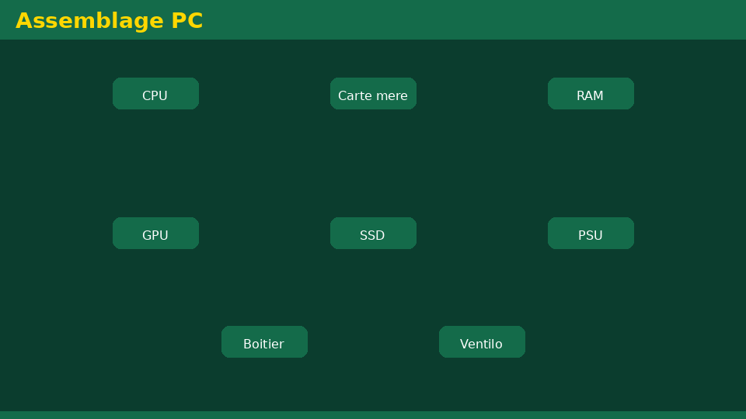
• Statement:Define: computing, hardware, software, CPU, RAM, SSD.
• Statement:Classify: keyboard, screen, processor, printer, microphone, hard drive.
• Statement:Why does an unsaved document disappear after a power outage?
📝 Points clés à retenir
Université de Mostaganem — Dr. Madani BELACEL

Slide 13
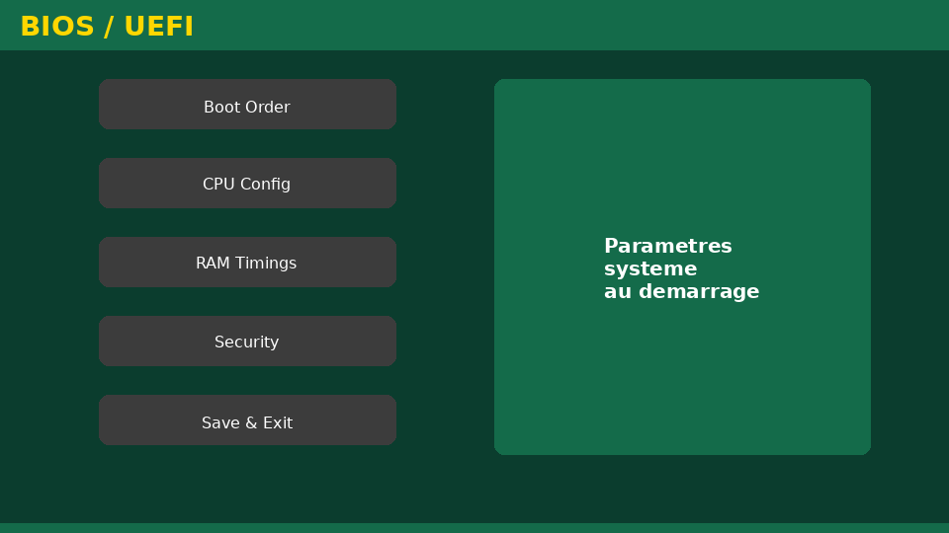
Université de Mostaganem — Dr. Madani BELACEL
📝 Points clés à retenir
• Statement:Define: computing, hardware, software, CPU, RAM, SSD.
• Statement:Classify: keyboard, screen, processor, printer, microphone, hard drive.
• Statement:Why does an unsaved document disappear after a power outage?
• Statement:For daily work, long-term archive, file transport — recommend media and justify.
• Statement:List 6 important best practices for a student.

Slide 14
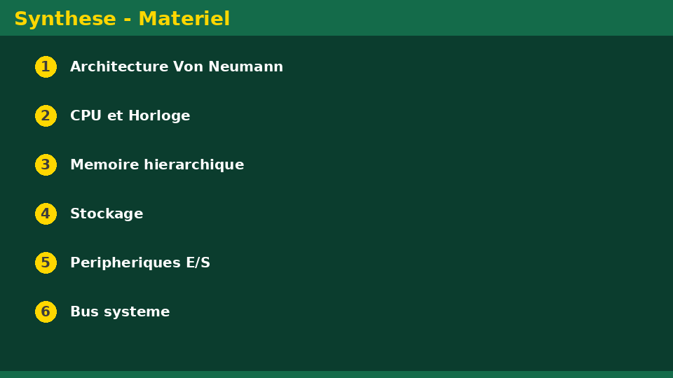
Université de Mostaganem — Dr. Madani BELACEL
✏️ Exercices d'application
• Définir les concepts principaux du cours
• Identifier les applications pratiques
• Résoudre les exercices du TD
• Synthétiser les points clés en un paragraphe
• Préparer une courte présentation orale

Slide 15
Université de Mostaganem — Dr. Madani BELACEL
🎓 Conclusion
Dr. BELACEL Madani Maître de Conférences B Université de Mostaganem madani.belacel@univ-mosta.dz

